Slide 1

AI training group
Weekly Report
Nguyen khai phu – SEP 7 2023

Slide 2
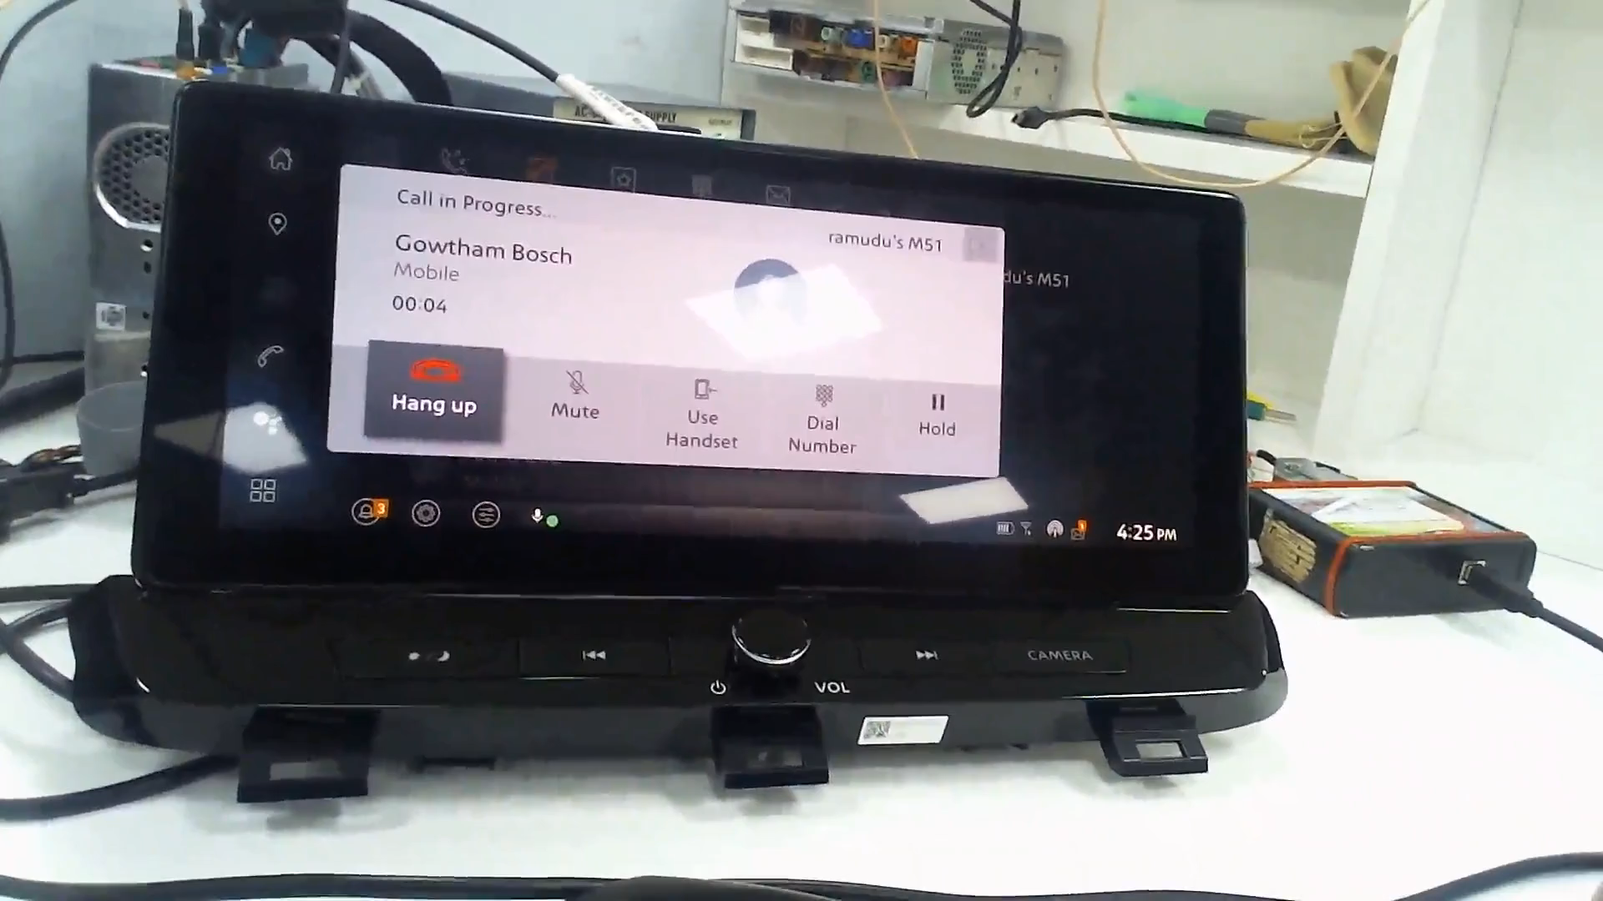
Group 1: Chaotic switch
ISP008 foundation
2
CISP-1352-A21 - ISP-DOC-STYLETYPE-Templates © Robert Bosch GmbH 2016. All rights reserved, also regarding any disposal, exploitation, reproduction, editing, distribution, as well as in the event of applications for industrial property rights.

Slide 3
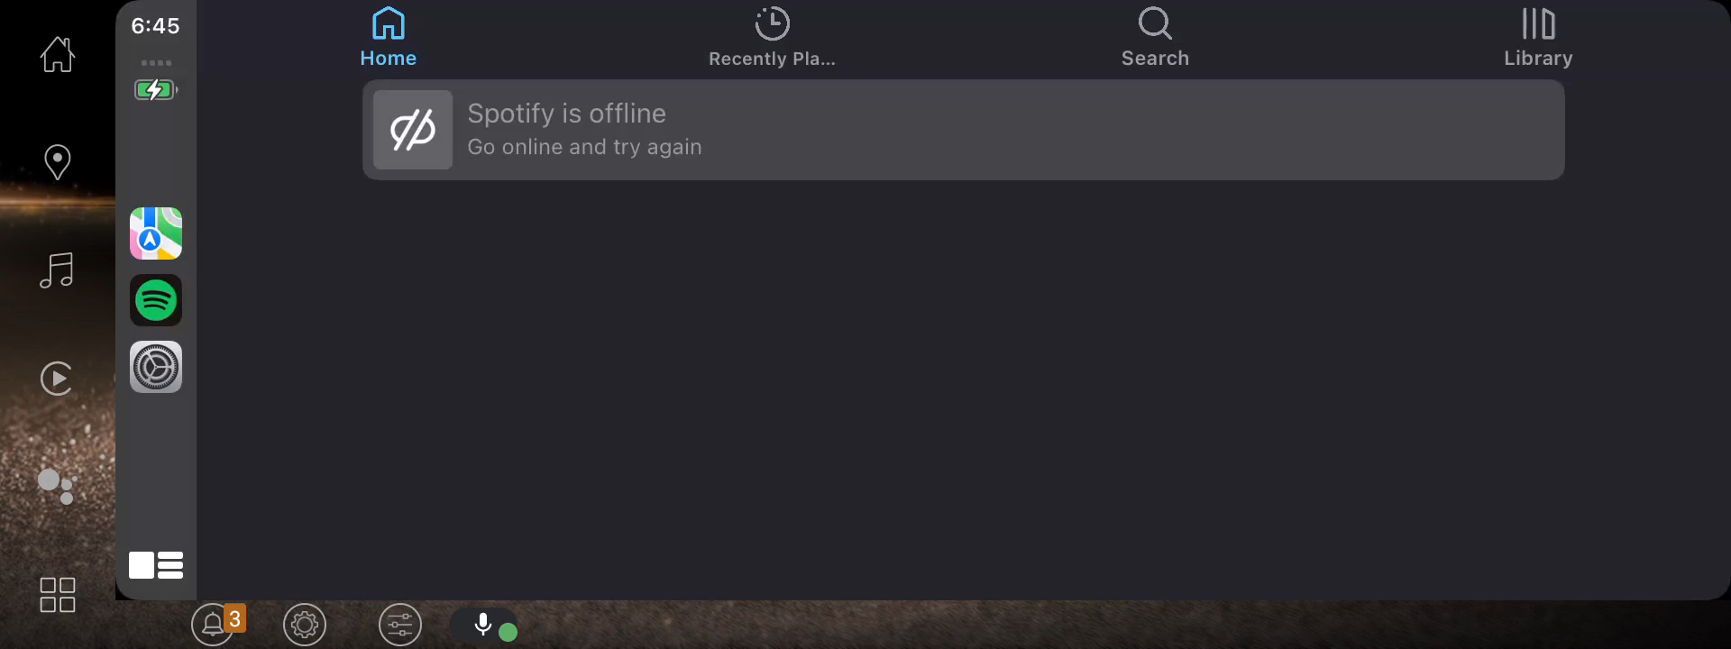
Group 2: Frame error
ISP008 foundation
2
CISP-1352-A21 - ISP-DOC-STYLETYPE-Templates © Robert Bosch GmbH 2016. All rights reserved, also regarding any disposal, exploitation, reproduction, editing, distribution, as well as in the event of applications for industrial property rights.

Slide 4
Group 2: Frame error
ISP008 foundation
A lot more common than other types
Mostly happen on tab/page transitions
2
CISP-1352-A21 - ISP-DOC-STYLETYPE-Templates © Robert Bosch GmbH 2016. All rights reserved, also regarding any disposal, exploitation, reproduction, editing, distribution, as well as in the event of applications for industrial property rights.

Slide 5
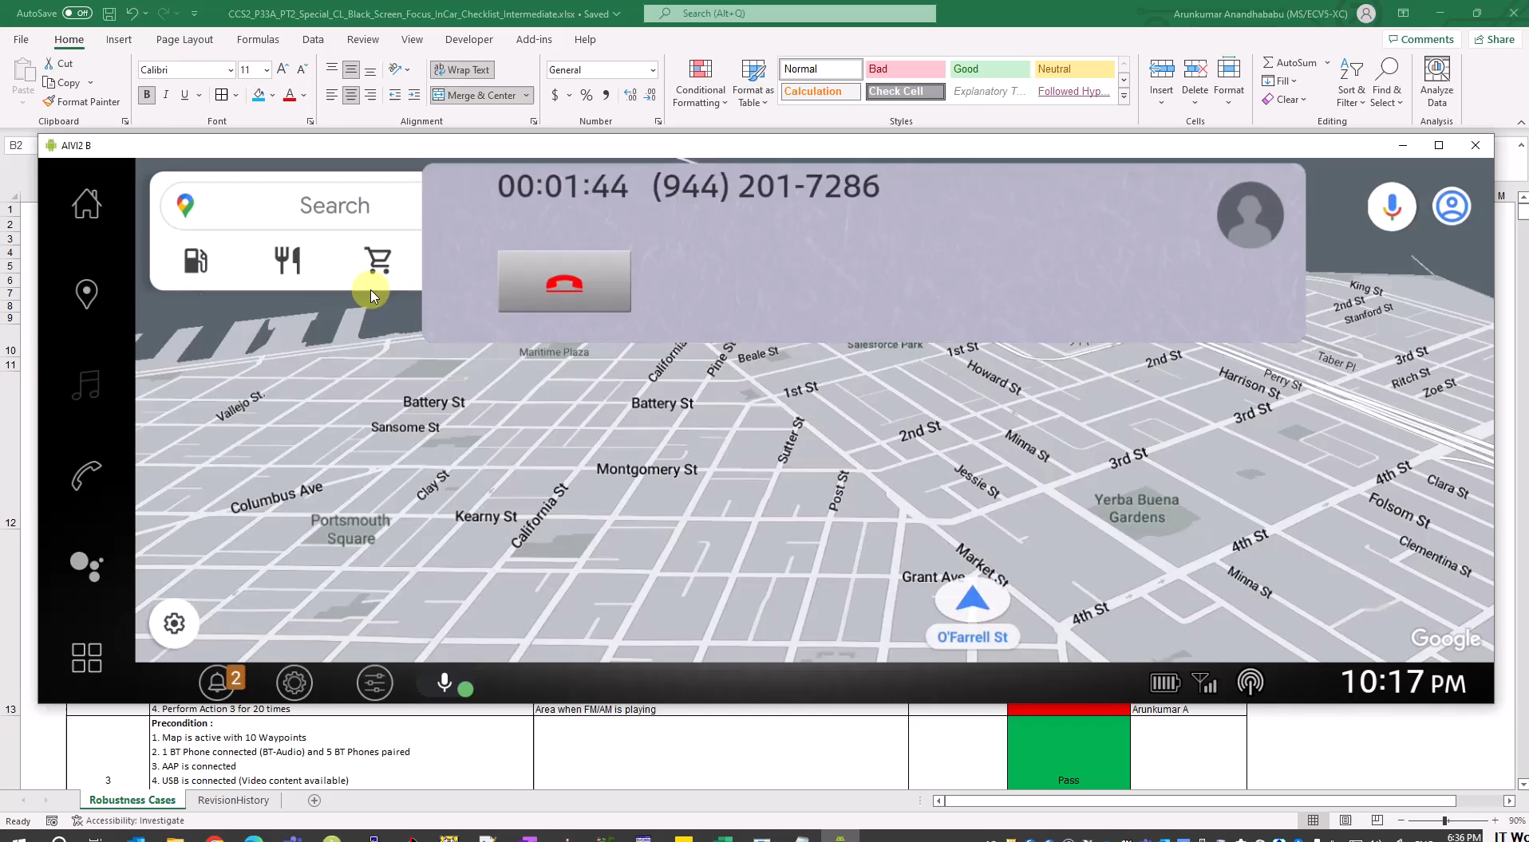
Group 3: Object
ISP008 foundation
2
CISP-1352-A21 - ISP-DOC-STYLETYPE-Templates © Robert Bosch GmbH 2016. All rights reserved, also regarding any disposal, exploitation, reproduction, editing, distribution, as well as in the event of applications for industrial property rights.

Slide 6
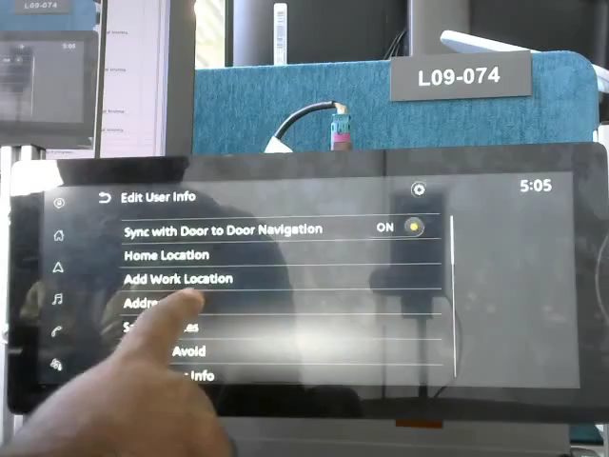
Group 4: list - slider
ISP008 foundation
2
CISP-1352-A21 - ISP-DOC-STYLETYPE-Templates © Robert Bosch GmbH 2016. All rights reserved, also regarding any disposal, exploitation, reproduction, editing, distribution, as well as in the event of applications for industrial property rights.

Slide 7
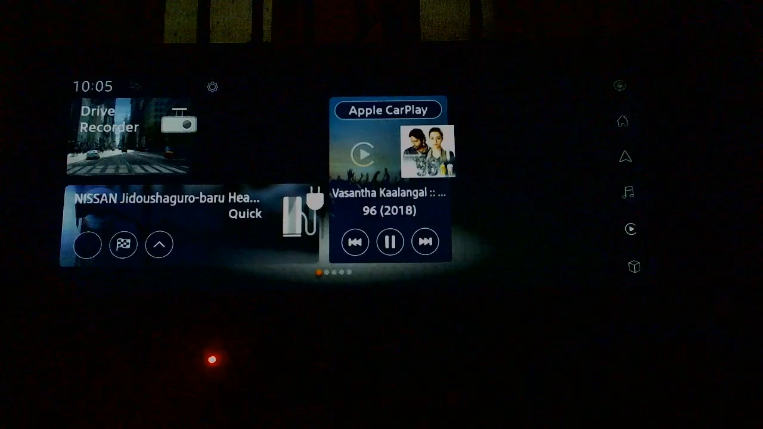
Group 5: screen slide
ISP008 foundation
2
CISP-1352-A21 - ISP-DOC-STYLETYPE-Templates © Robert Bosch GmbH 2016. All rights reserved, also regarding any disposal, exploitation, reproduction, editing, distribution, as well as in the event of applications for industrial property rights.

Slide 8
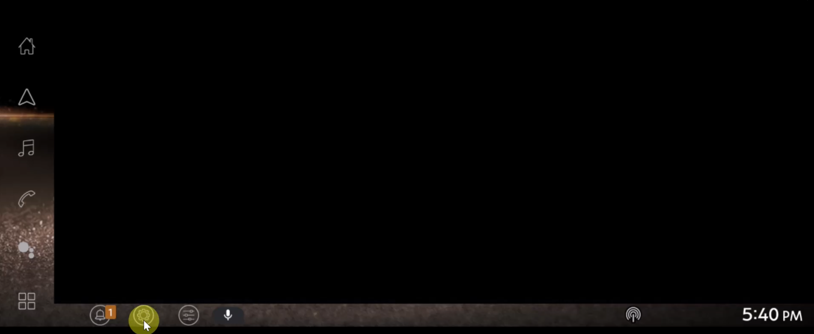
Group 6: blank screen
ISP008 foundation
2
CISP-1352-A21 - ISP-DOC-STYLETYPE-Templates © Robert Bosch GmbH 2016. All rights reserved, also regarding any disposal, exploitation, reproduction, editing, distribution, as well as in the event of applications for industrial property rights.

Slide 9
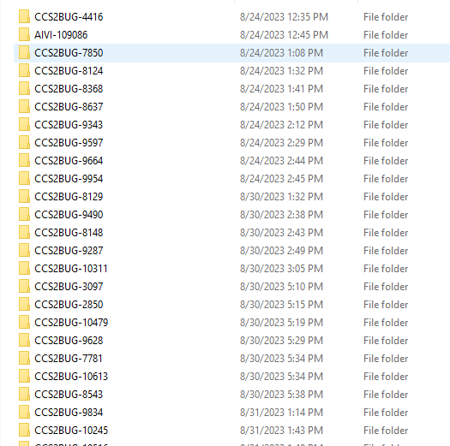
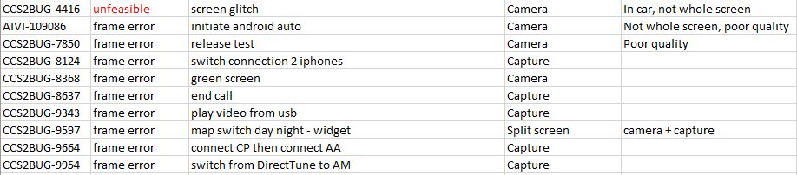
Analysis – Collect data
ISP008 foundation
132 issues - 200 test case clips
Categorization, simple processing
2
CISP-1352-A21 - ISP-DOC-STYLETYPE-Templates © Robert Bosch GmbH 2016. All rights reserved, also regarding any disposal, exploitation, reproduction, editing, distribution, as well as in the event of applications for industrial property rights.

Slide 10
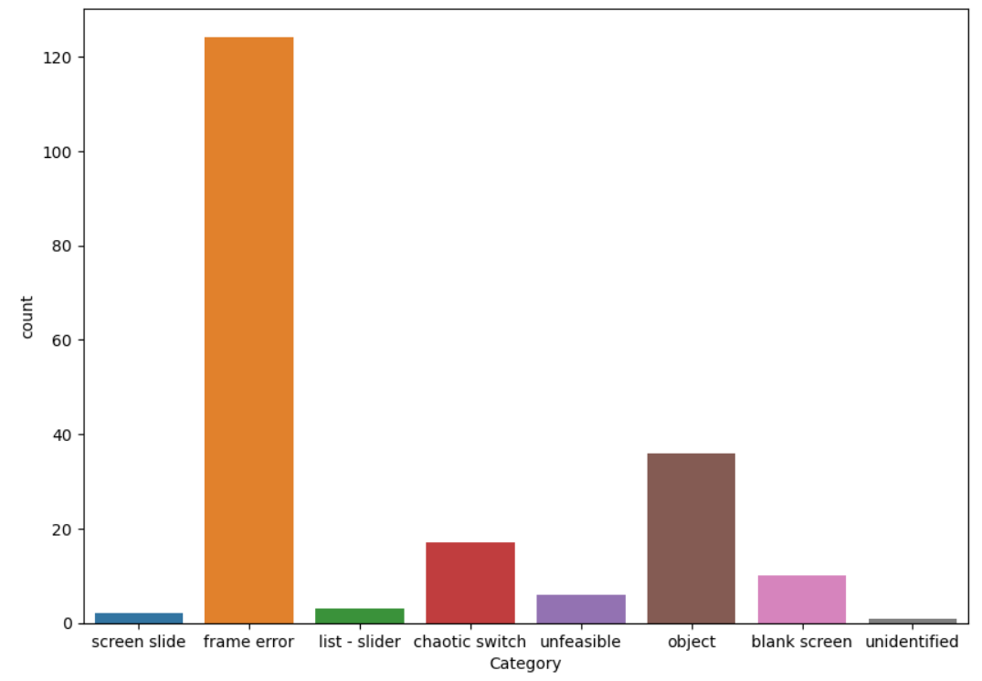
Analysis – 8 categories
ISP008 foundation
Most flickers happen on screen transitions
Unfeasible due to: interaction with hardwares, how test cases are recorded, the bug itself,...
2
CISP-1352-A21 - ISP-DOC-STYLETYPE-Templates © Robert Bosch GmbH 2016. All rights reserved, also regarding any disposal, exploitation, reproduction, editing, distribution, as well as in the event of applications for industrial property rights.

Slide 11
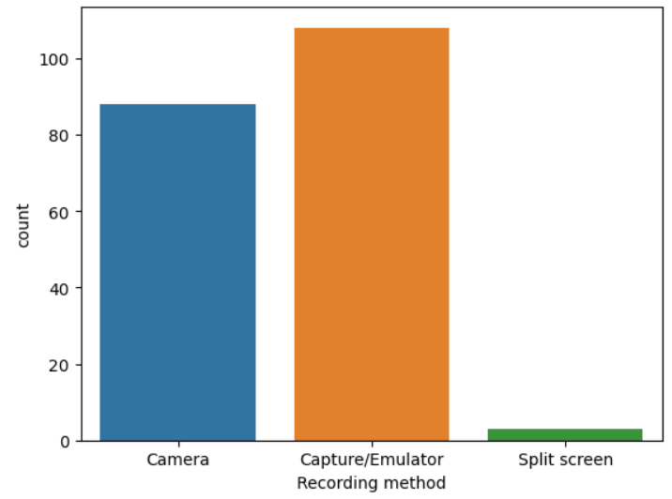
Analysis – Recording methods
ISP008 foundation
2
CISP-1352-A21 - ISP-DOC-STYLETYPE-Templates © Robert Bosch GmbH 2016. All rights reserved, also regarding any disposal, exploitation, reproduction, editing, distribution, as well as in the event of applications for industrial property rights.

Slide 12
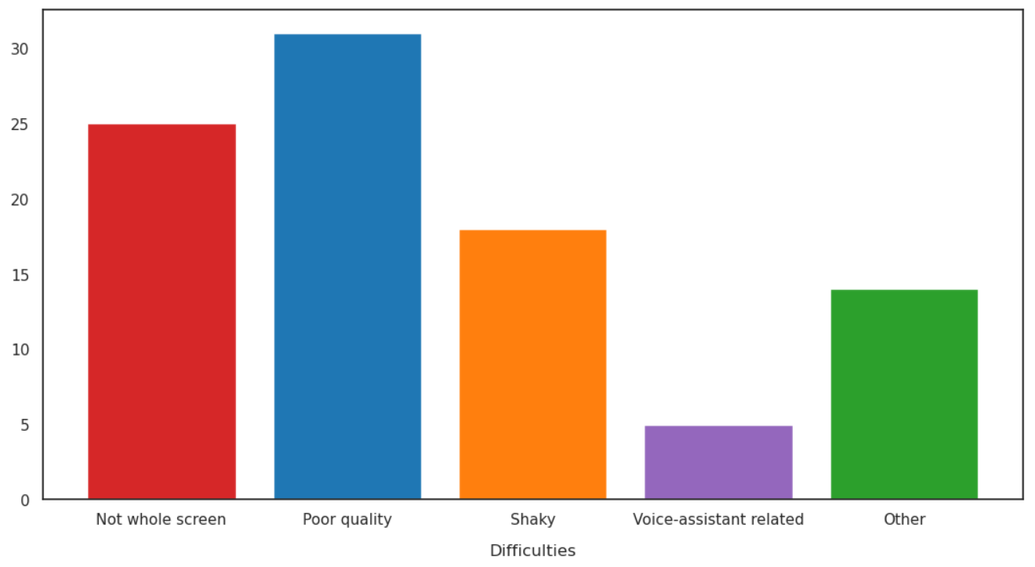
Analysis – Difficulties
ISP008 foundation
2
CISP-1352-A21 - ISP-DOC-STYLETYPE-Templates © Robert Bosch GmbH 2016. All rights reserved, also regarding any disposal, exploitation, reproduction, editing, distribution, as well as in the event of applications for industrial property rights.

Slide 13
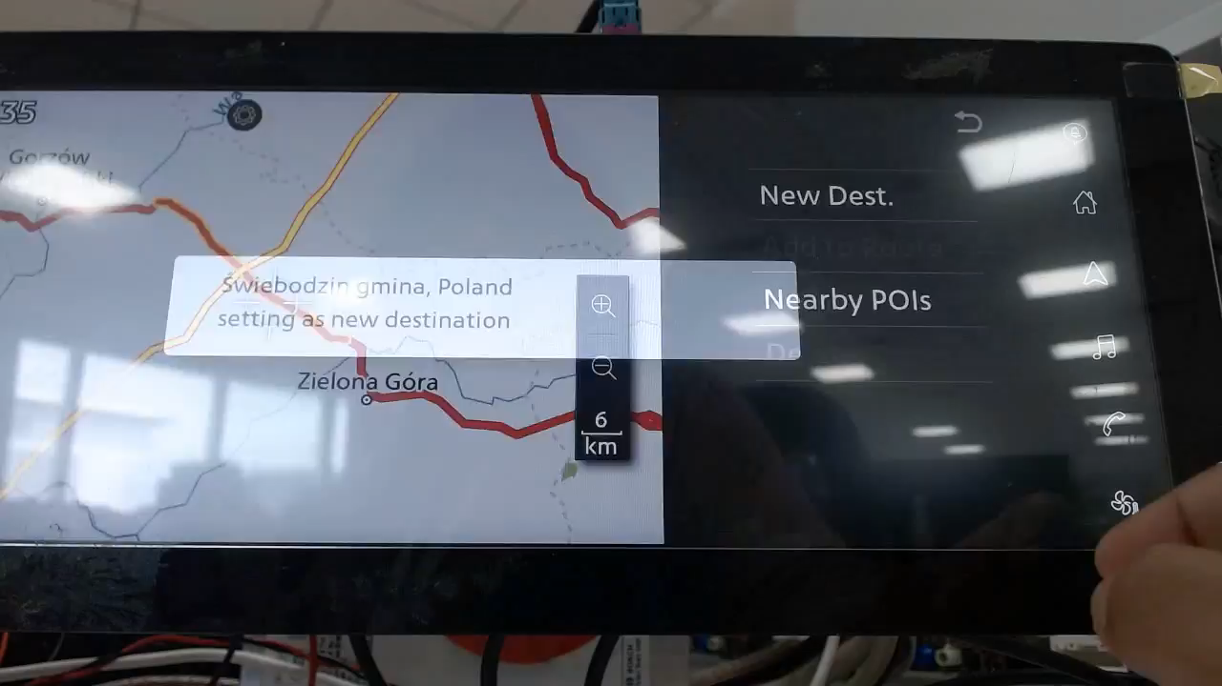
ISP008 foundation
2
CISP-1352-A21 - ISP-DOC-STYLETYPE-Templates © Robert Bosch GmbH 2016. All rights reserved, also regarding any disposal, exploitation, reproduction, editing, distribution, as well as in the event of applications for industrial property rights.

Slide 14
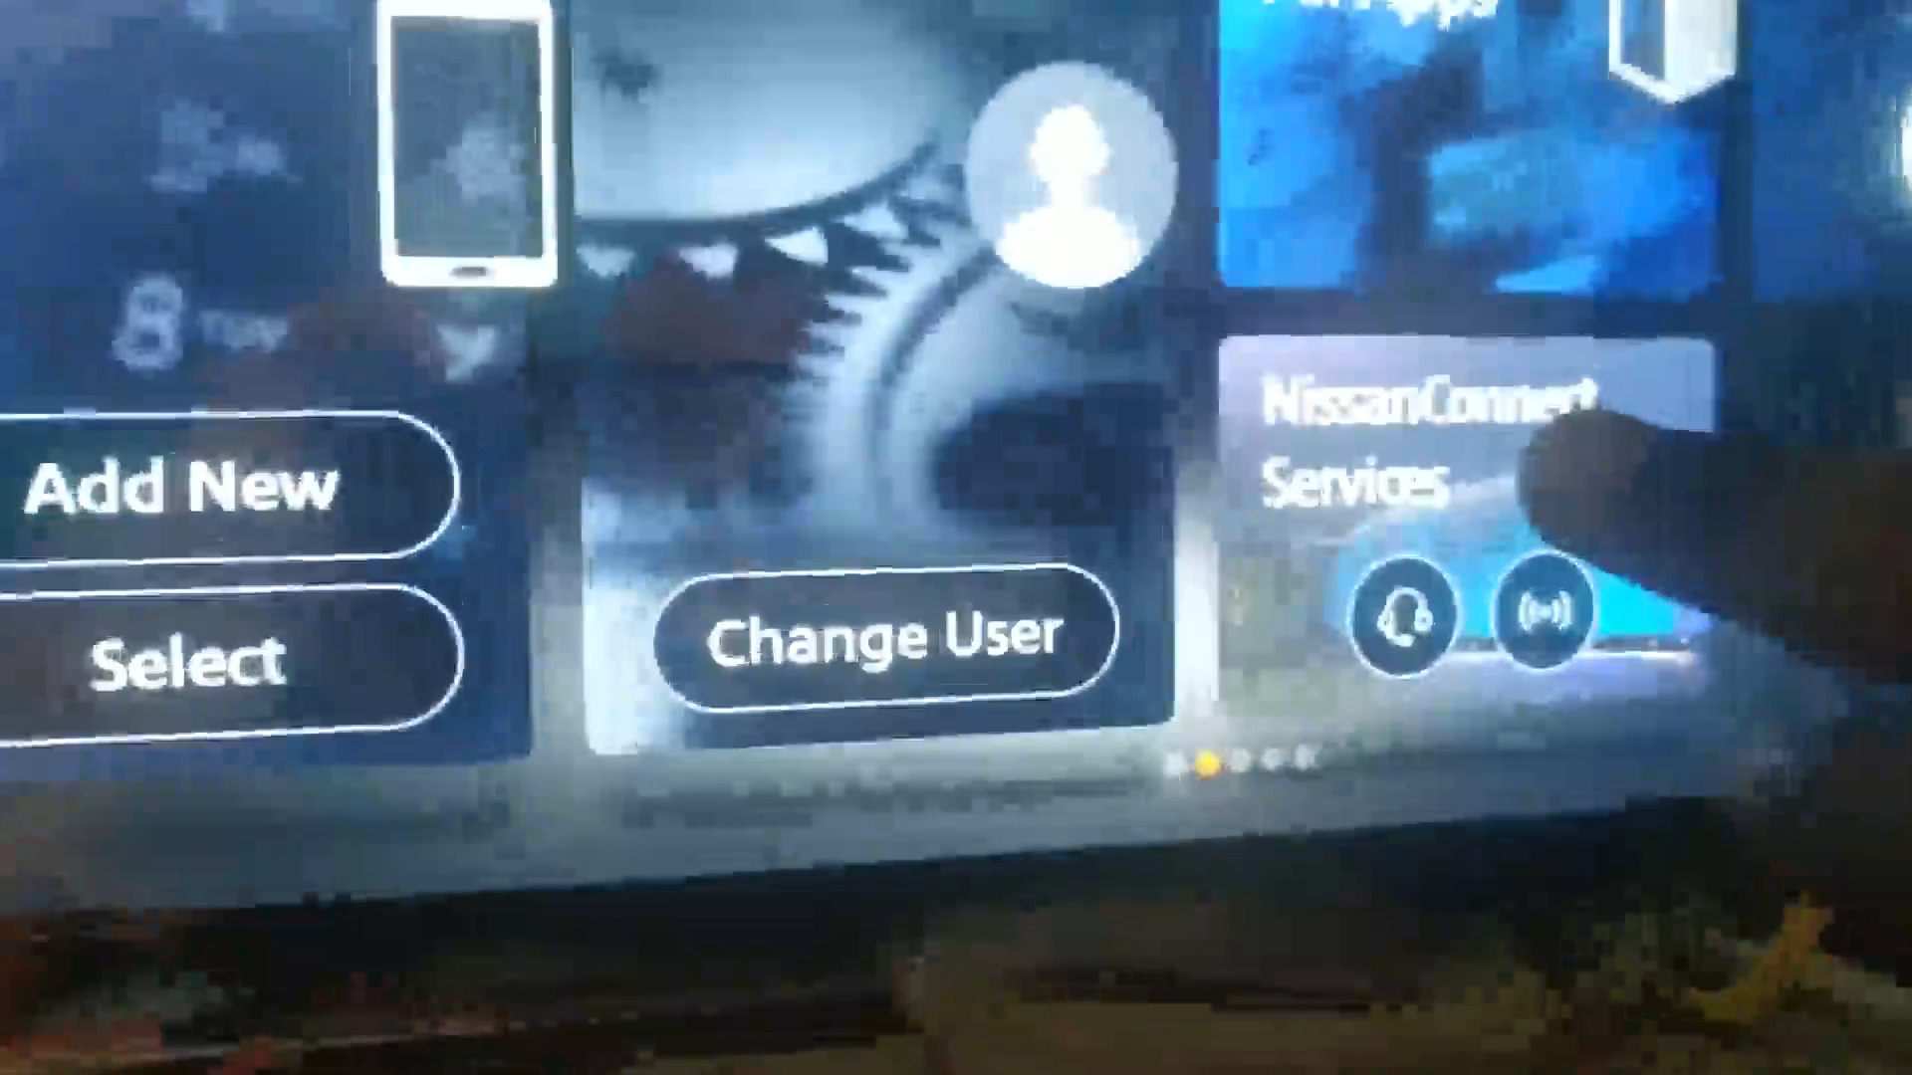
ISP008 foundation
2
CISP-1352-A21 - ISP-DOC-STYLETYPE-Templates © Robert Bosch GmbH 2016. All rights reserved, also regarding any disposal, exploitation, reproduction, editing, distribution, as well as in the event of applications for industrial property rights.

Slide 15
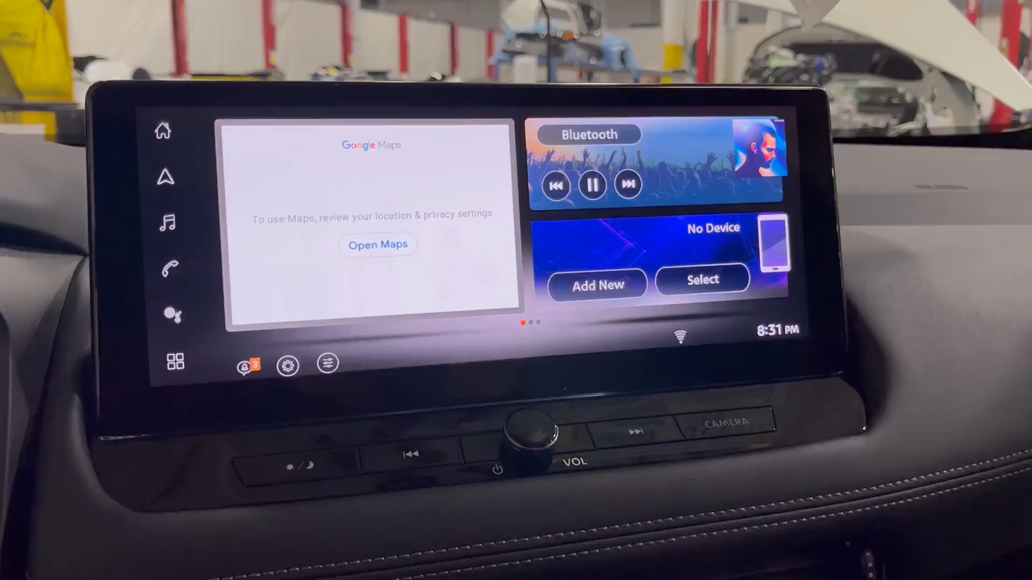
ISP008 foundation
2
CISP-1352-A21 - ISP-DOC-STYLETYPE-Templates © Robert Bosch GmbH 2016. All rights reserved, also regarding any disposal, exploitation, reproduction, editing, distribution, as well as in the event of applications for industrial property rights.

Slide 16
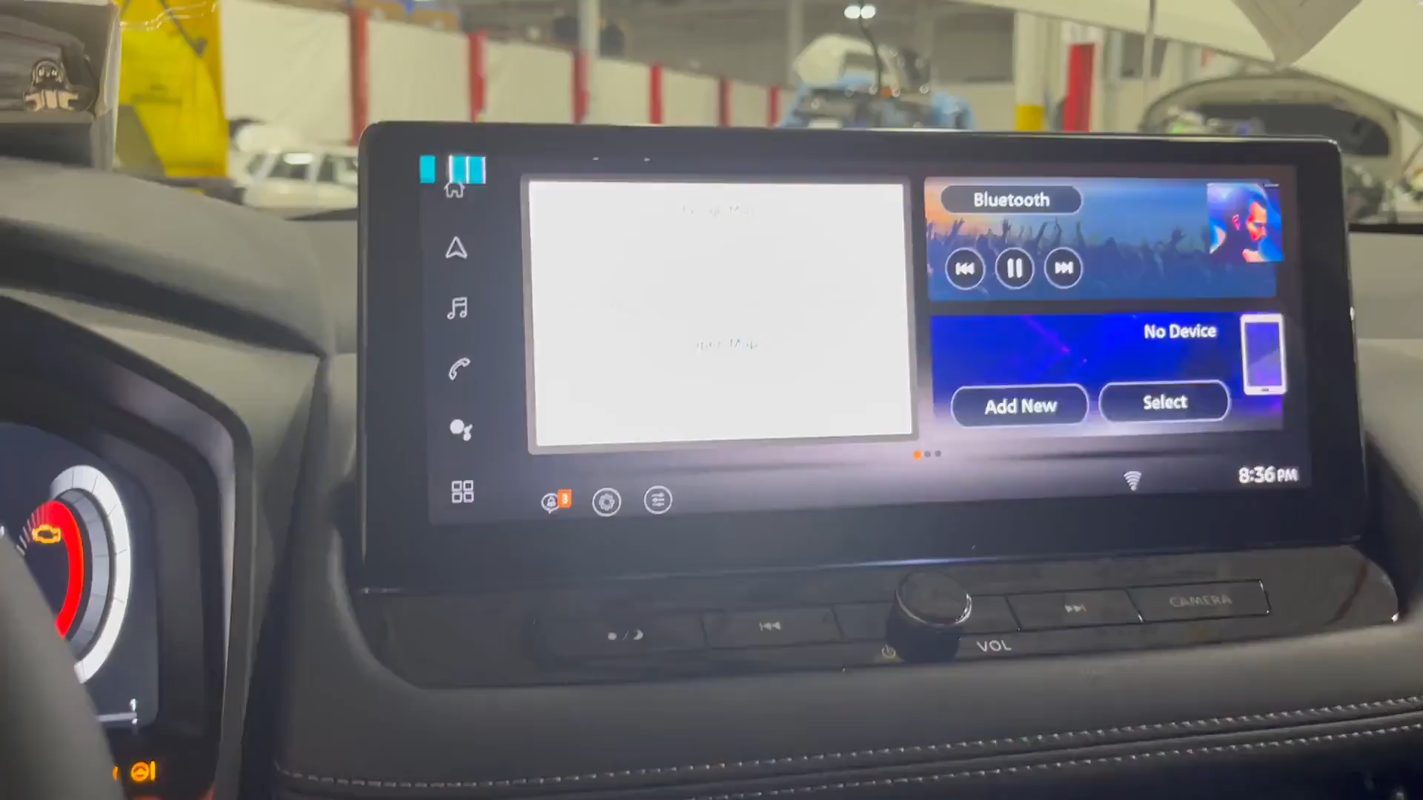
ISP008 foundation
2
CISP-1352-A21 - ISP-DOC-STYLETYPE-Templates © Robert Bosch GmbH 2016. All rights reserved, also regarding any disposal, exploitation, reproduction, editing, distribution, as well as in the event of applications for industrial property rights.

Slide 17
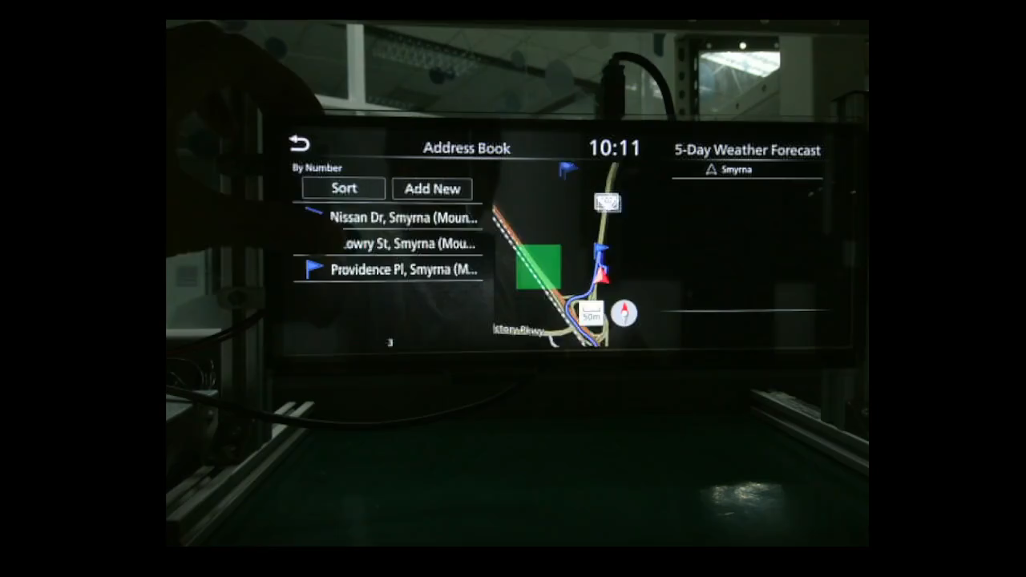
ISP008 foundation
2
CISP-1352-A21 - ISP-DOC-STYLETYPE-Templates © Robert Bosch GmbH 2016. All rights reserved, also regarding any disposal, exploitation, reproduction, editing, distribution, as well as in the event of applications for industrial property rights.

Slide 18
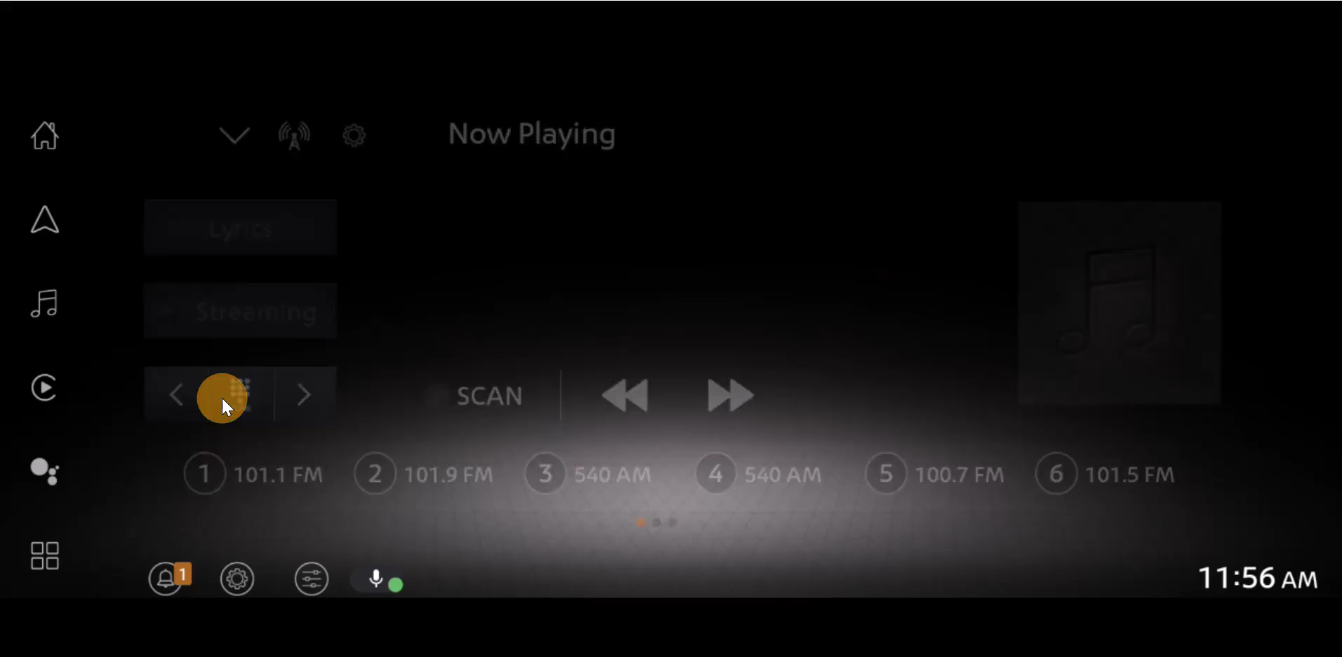
ISP008 foundation
2
CISP-1352-A21 - ISP-DOC-STYLETYPE-Templates © Robert Bosch GmbH 2016. All rights reserved, also regarding any disposal, exploitation, reproduction, editing, distribution, as well as in the event of applications for industrial property rights.

Slide 19
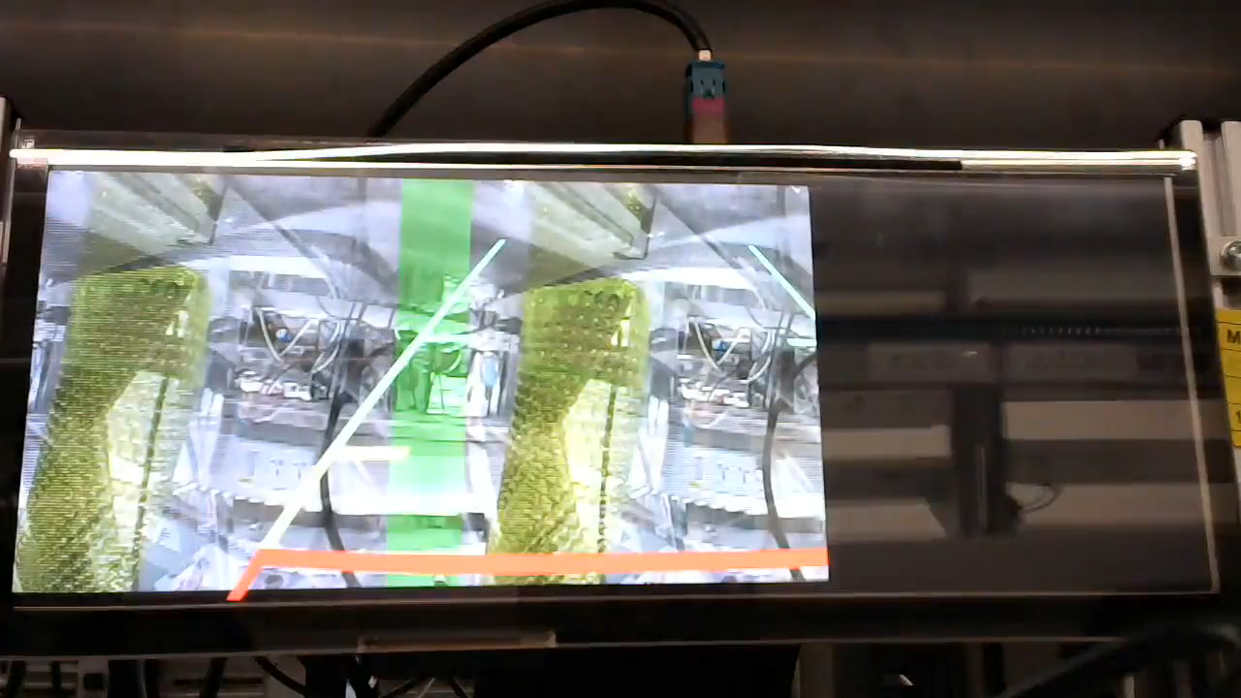
ISP008 foundation
2
CISP-1352-A21 - ISP-DOC-STYLETYPE-Templates © Robert Bosch GmbH 2016. All rights reserved, also regarding any disposal, exploitation, reproduction, editing, distribution, as well as in the event of applications for industrial property rights.

Slide 20
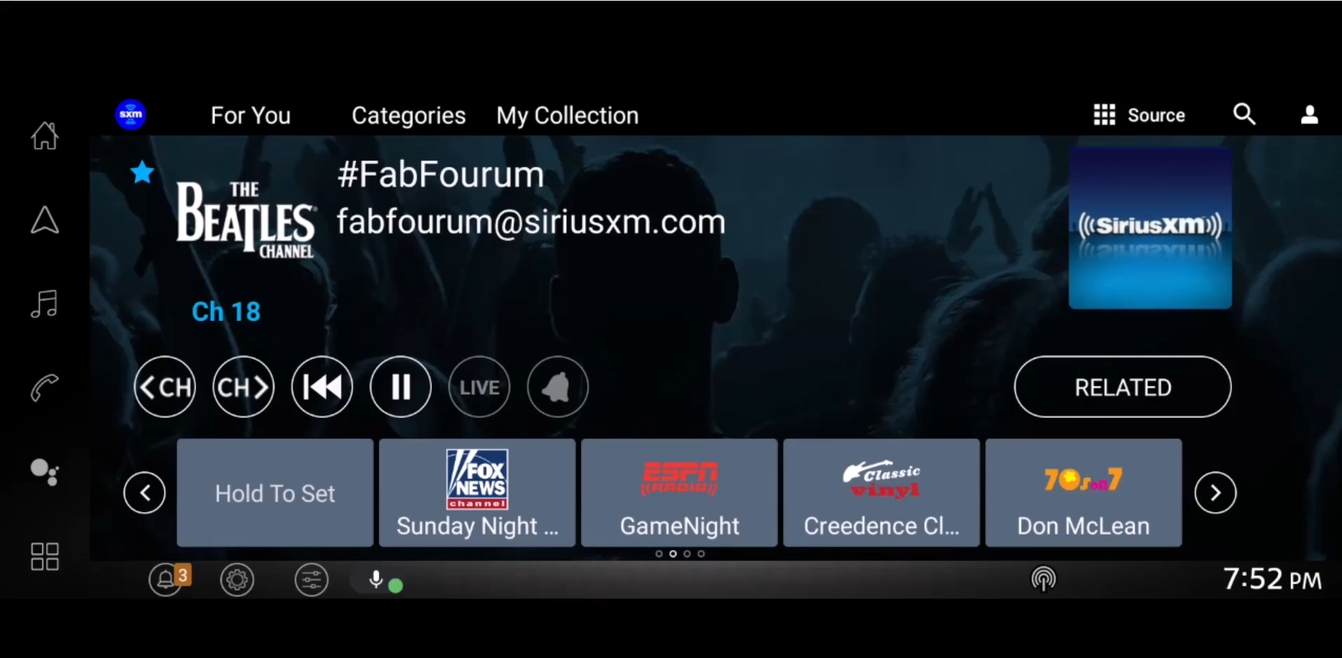
ISP008 foundation
2
CISP-1352-A21 - ISP-DOC-STYLETYPE-Templates © Robert Bosch GmbH 2016. All rights reserved, also regarding any disposal, exploitation, reproduction, editing, distribution, as well as in the event of applications for industrial property rights.

Slide 21
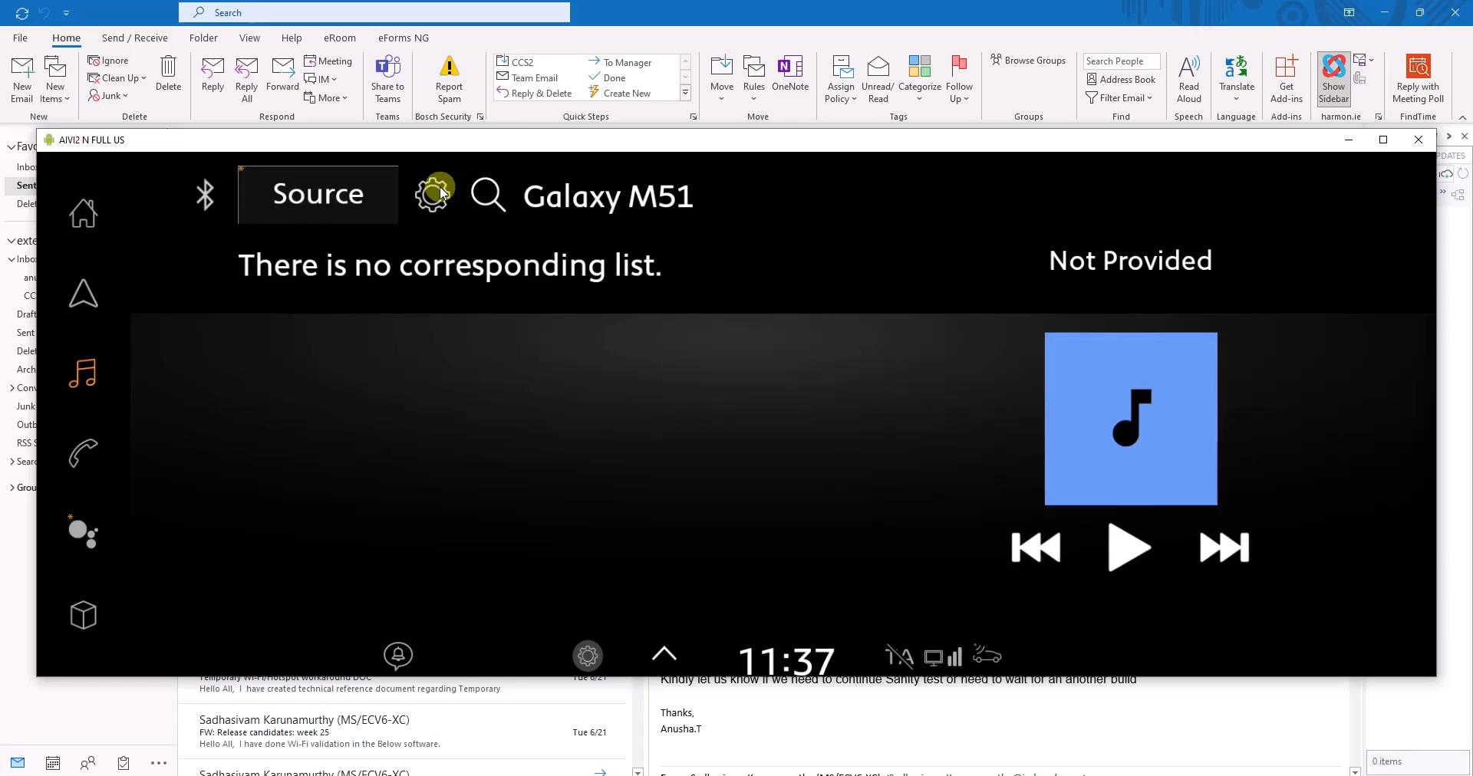
ISP008 foundation
2
CISP-1352-A21 - ISP-DOC-STYLETYPE-Templates © Robert Bosch GmbH 2016. All rights reserved, also regarding any disposal, exploitation, reproduction, editing, distribution, as well as in the event of applications for industrial property rights.

